Slide 1

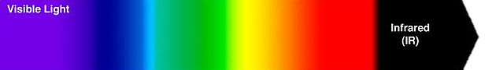
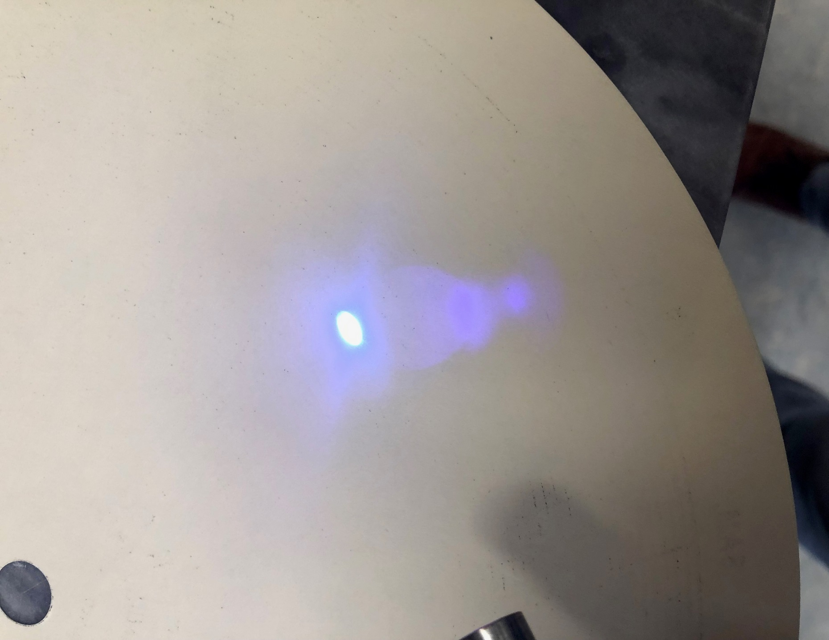
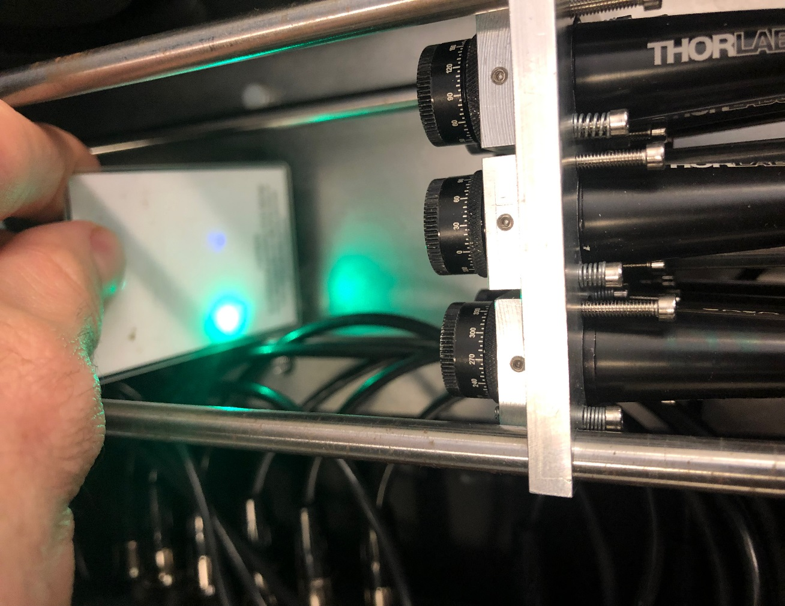
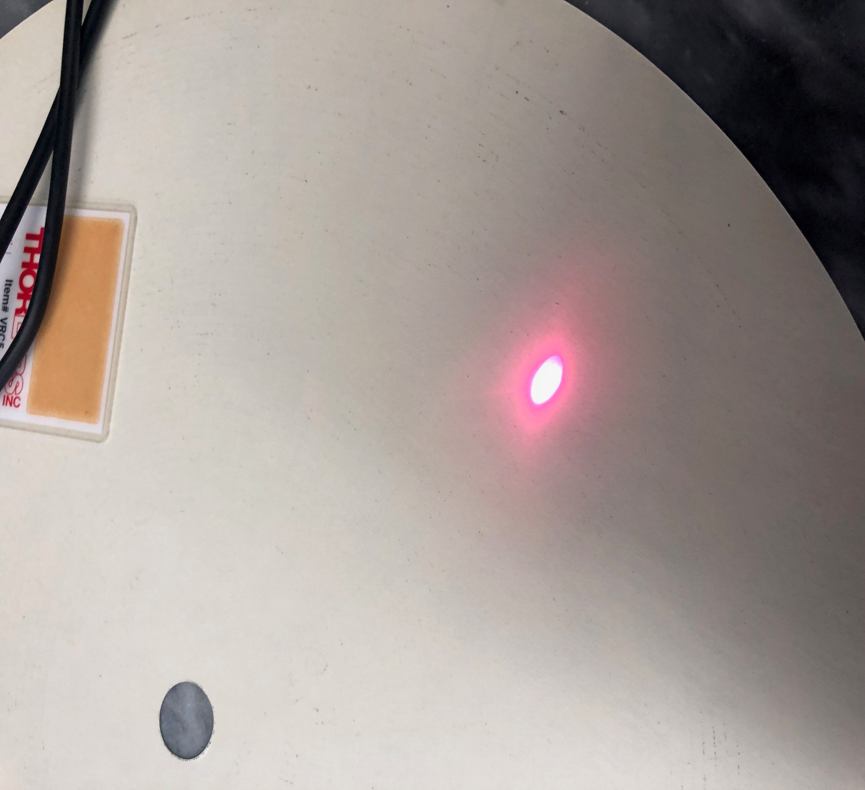
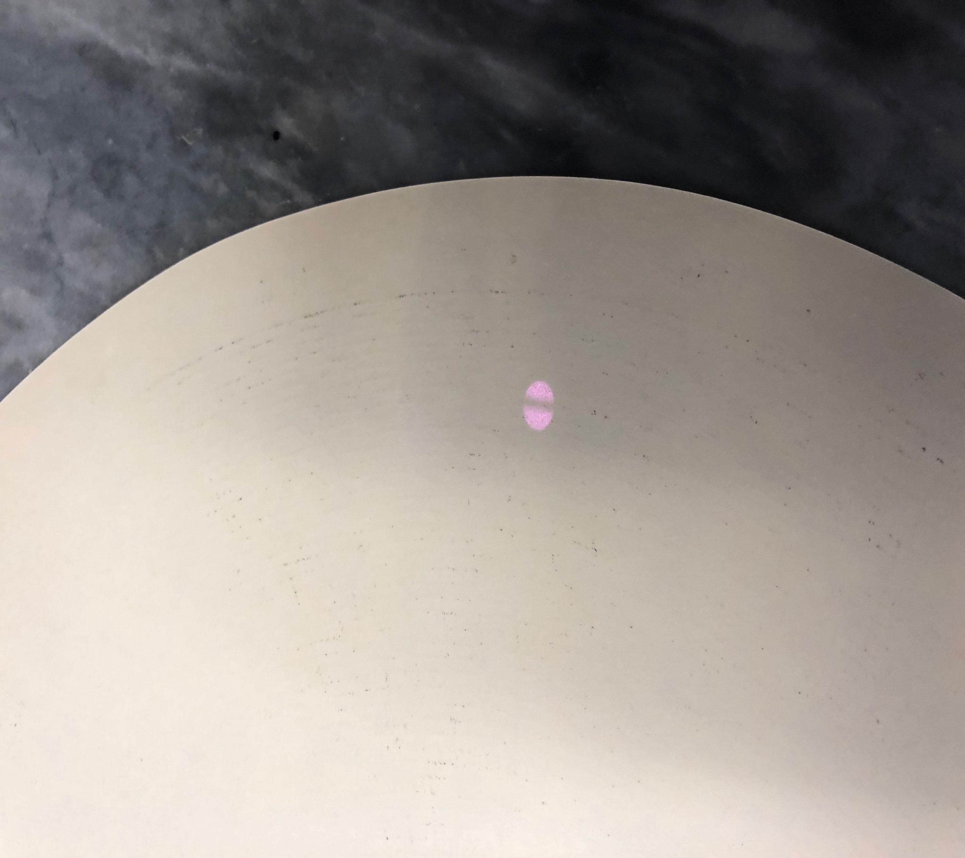
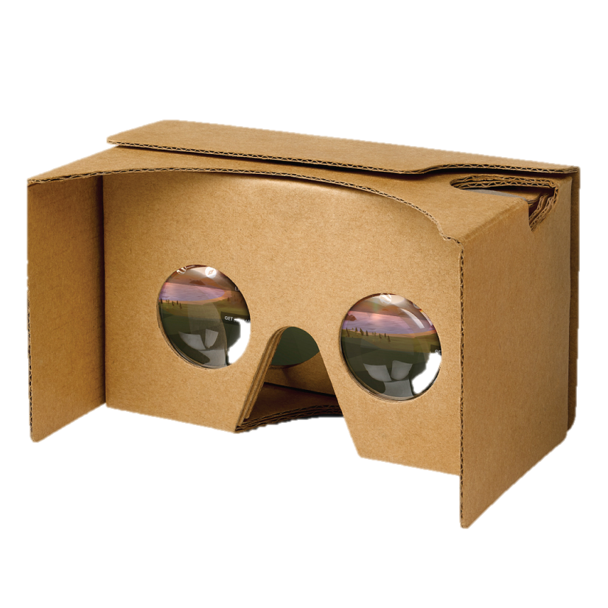
Virtual Reality Universal Laser Safety Goggles
Laser and Optics Douplik Group (LODG), Ryerson University Physics Department Prof. Alxandre (Sasha) Douplik, Faraz Sadrzadeh-Afsharazar (MASc)
Introduction
A Virtual Reality (VR) headset was utilized to facilitate a safe indirect visual observation of visible and IR laser beams of various power levels. Google cardboard was used as a proof of concept prototype. Through the use of the camera application on an IPhone X, a live video feed of the front camera was streamed onto the visor. This digitally isolated the laser light and the observed light light. The applications of such a headset are numerous, spanning medical, military, scientific, and industrial sectors.
Proof of Concept
Successfully observed laser wavelengths between 400-1000 nm Simultaneously
400nm
1000nm
Laser spots observable through the visor – Left to right: 405 nm, 520 nm, 685 nm, 980 nm (invisible to the eye)
γ
θ
x
Future Works
Through stereoscopic triangulation, beam angles and distances can be approximated. The auto-exposure allows for the observation of lasers of various power levels. Through image processing, laser beam characterization can be achieved.
Proof of Concept:
Google Cardboard + Any Smartphone!

